Slide 1

Project Presentation
Handwritten digit detection using CNN
SUBMISSION DATE : 9th December,2022

Slide 2
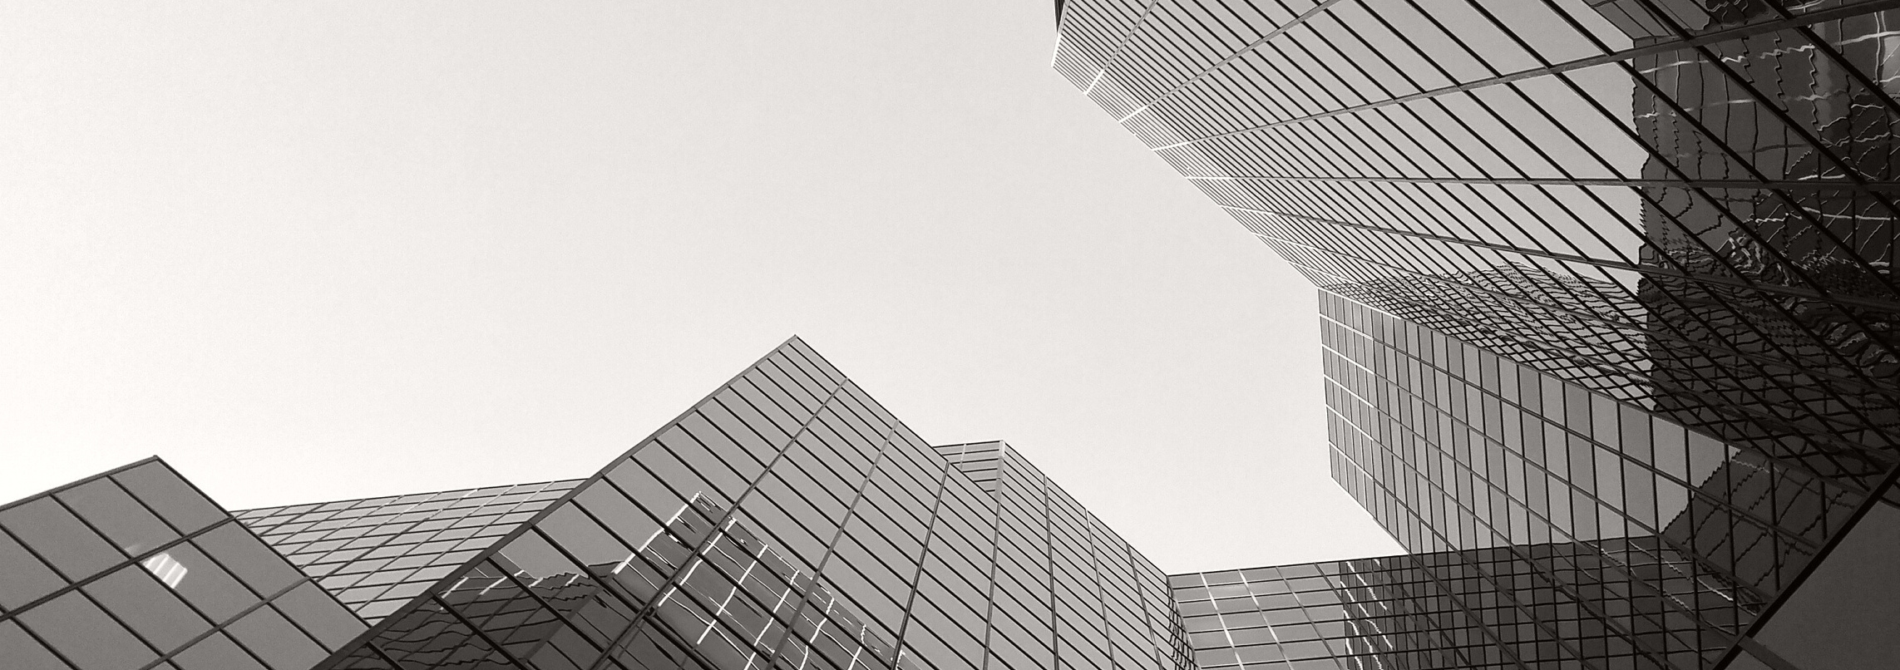
Abstract
PROJECT TIMELINE
The goal is to create a model that can detect human written digit using convolutional neural network
PAGE NUMBER

Slide 3



KEYS OF THIS PRESENTATION
PROJECT TIMELINE
IMPORTED MODULES
DATASET
ACCURACY
PAGE NUMBER

Slide 4
Modules imported
PROJECT TIMELINE
01 Tenserflow
02 Numpy
03 Matplotlib
It is a foundation library that can be used to create Deep Learning models directly or by using wrapper libraries that simplify the process
This library adds powerful data structures to Python that guarantee efficient calculations and it supplies an enormous library of high-level mathematical functions.
It is a cross-platform, data visualization and graphical plotting library for Python and its numerical extension NumPy
PAGE NUMBER

Slide 5
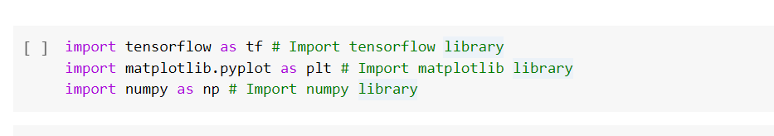
These libraries will help with precise calculations and plotting on the graph.

Slide 6
DATASET USED IN THE PRESENTATION
PROJECT TIMELINE
MNIST dataset
MNIST is a collection of handwritten digits ranging from the number 0 to 9.
It has a training set of 60,000 images, and 10,000 test images that are classified into corresponding categories or labels.
The following Keras code detects handwritten digits.
PAGE NUMBER

Slide 7
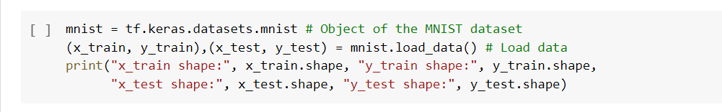
Loaded data from the Dataset

Slide 8
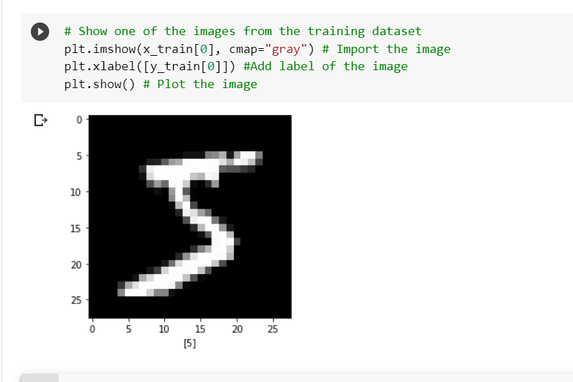
Plotting image and labeling
PROJECT TIMELINE
PAGE NUMBER

Slide 9
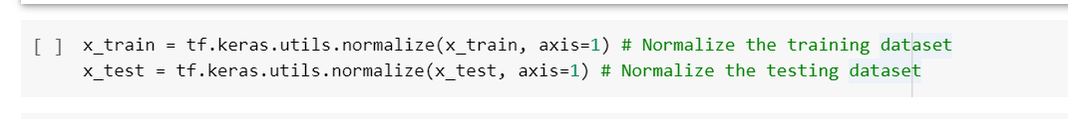
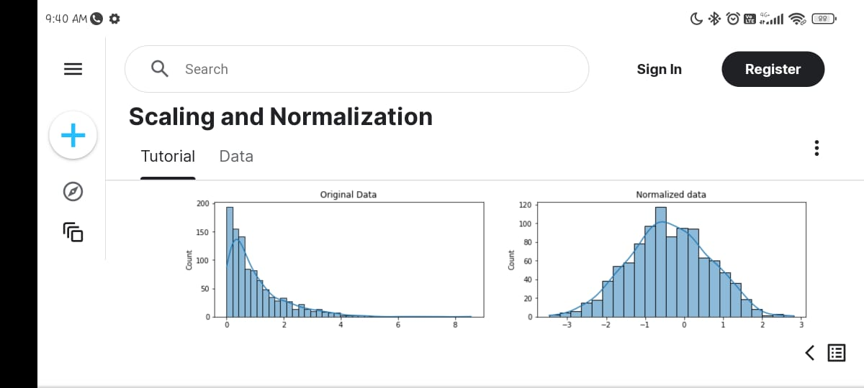
Normalizing data (This improves the performance and training stability of the model)
PROJECT TIMELINE
PAGE NUMBER

Slide 10
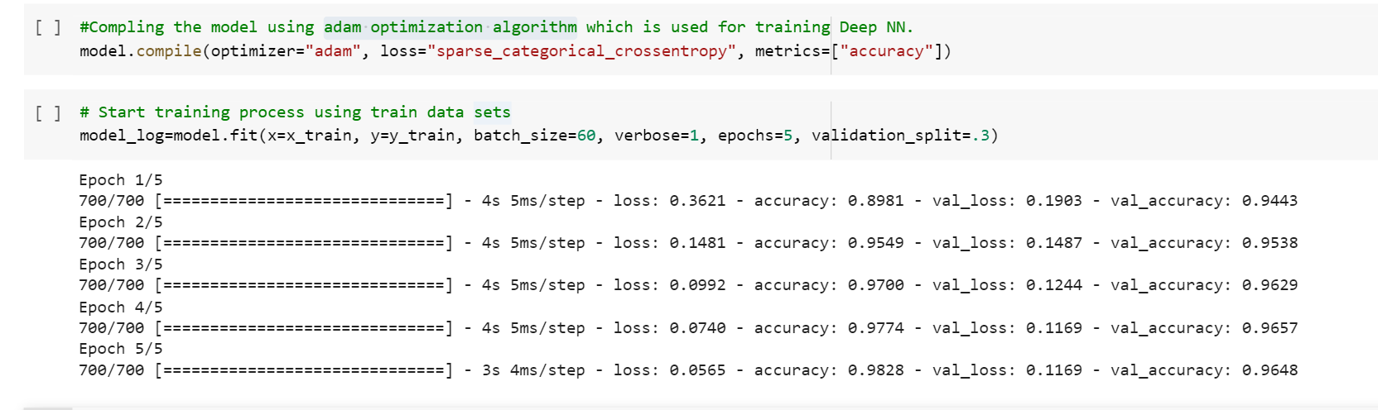
Optimizing data (adapt every epoch's weight and minimize the loss function)
PROJECT TIMELINE
PAGE NUMBER

Slide 11
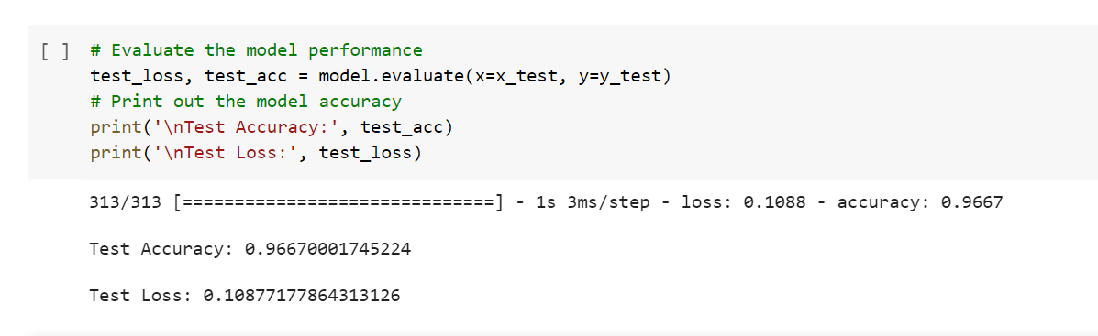
Accuracy of the model
PROJECT TIMELINE
PAGE NUMBER

Slide 12
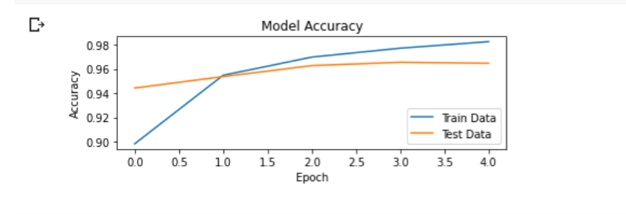
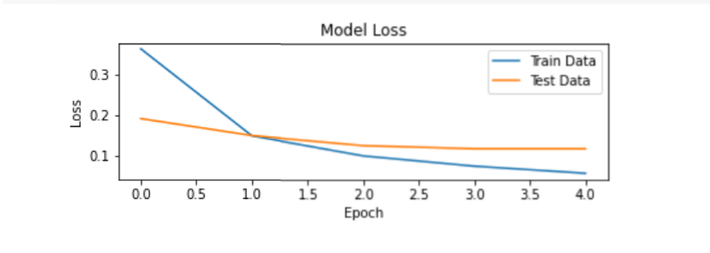
Output Stats
PROJECT TIMELINE
01
02
Accuracy Plot
Loss Plot
PAGE NUMBER

Slide 13
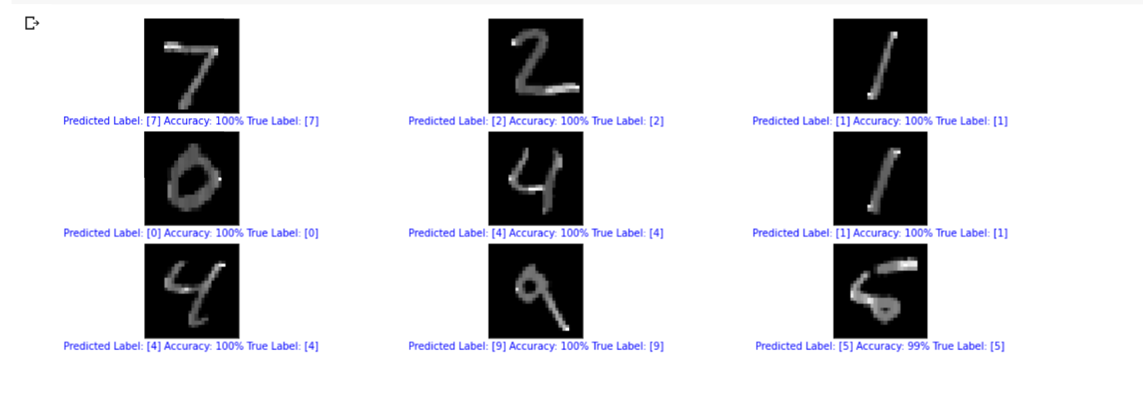
OUTPUT!

Slide 14

Thank you!
PROJECT TIMELINE
PAGE NUMBER

